Slide 1
JIRA
1.JIRA LOGIN
2.Its open empty backlogs page
3.Create Epic in Home page
4.Create a story in Register,login,contact pages
5.Start Spirit

Slide 2
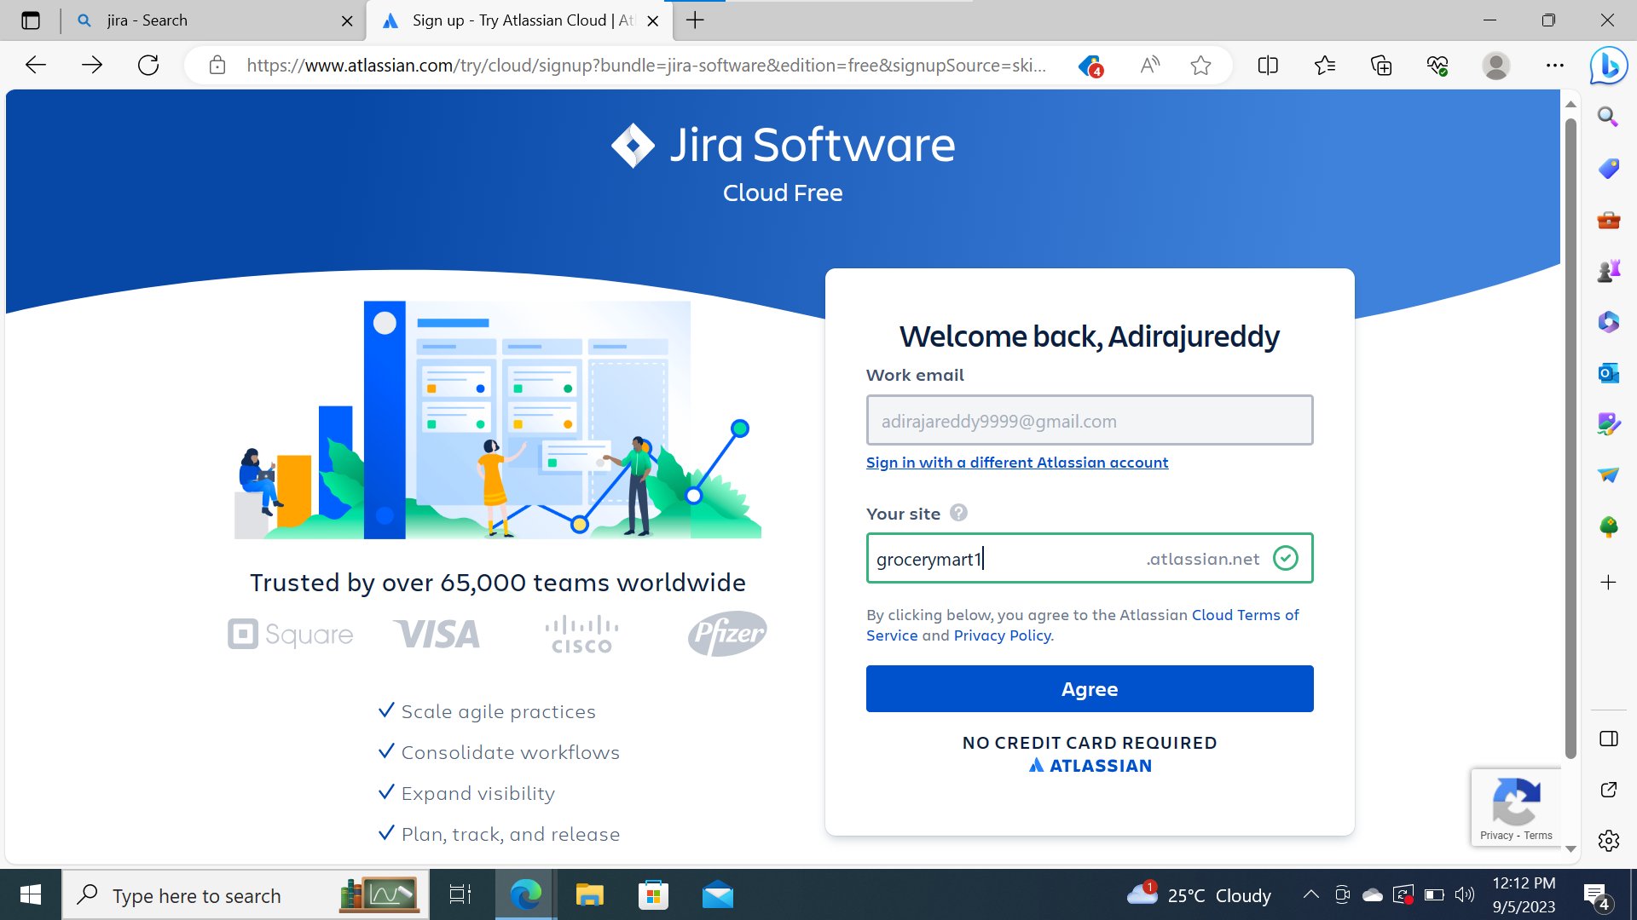
Jira login

Slide 3
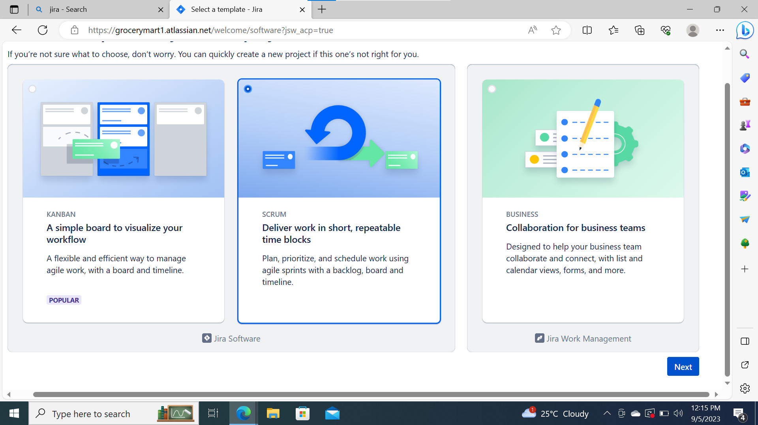

Slide 4
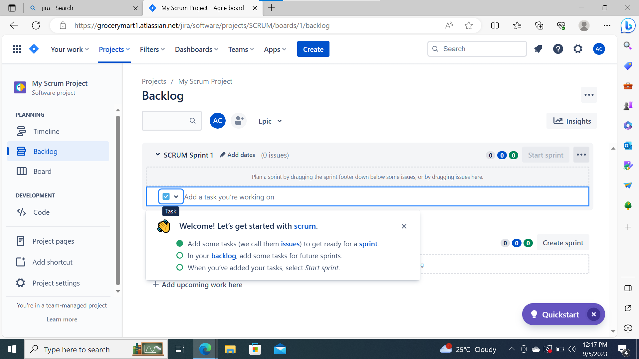
Its open a Empty Backlog

Slide 5
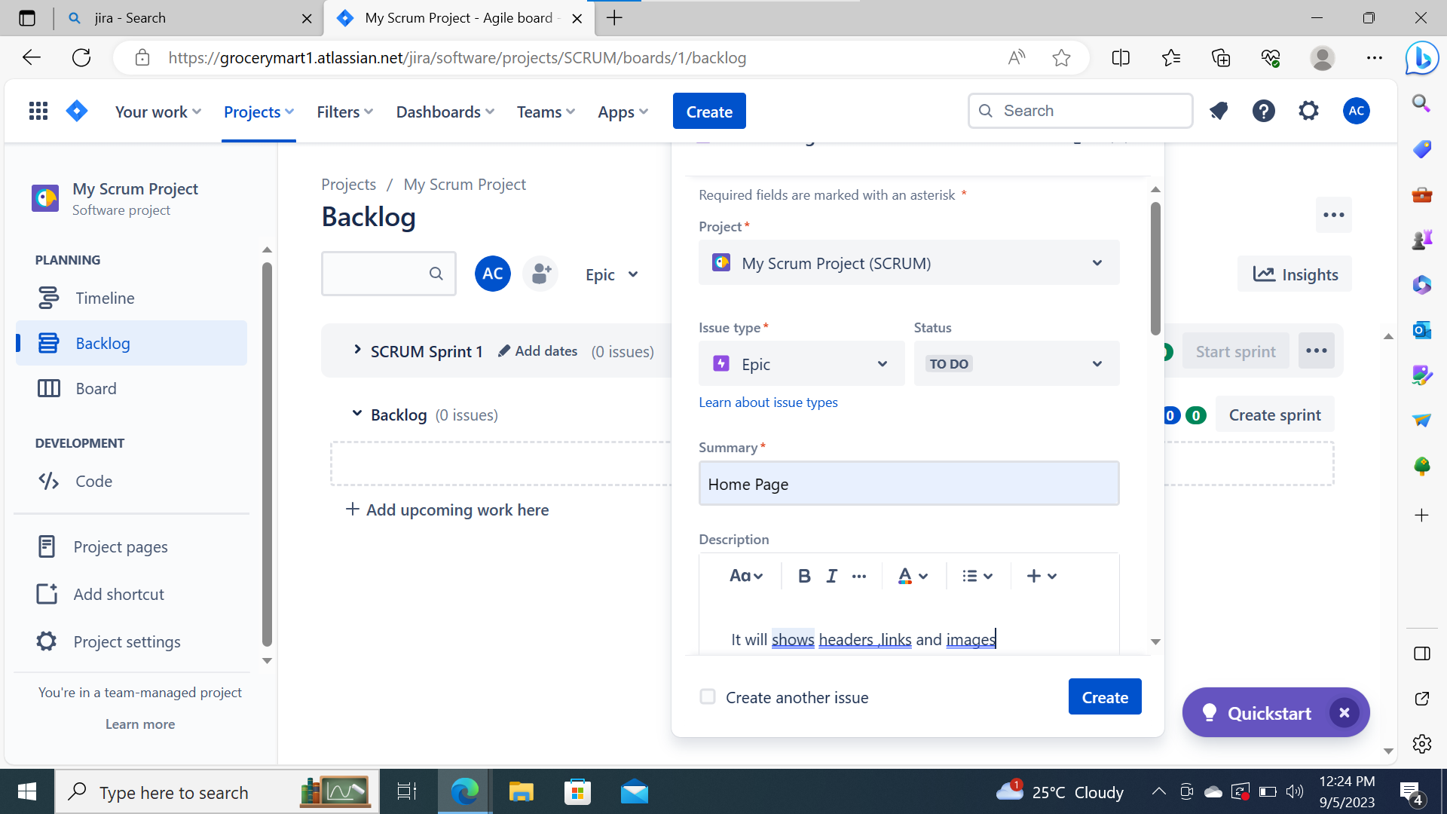
Create a Home page an Epic

Slide 6
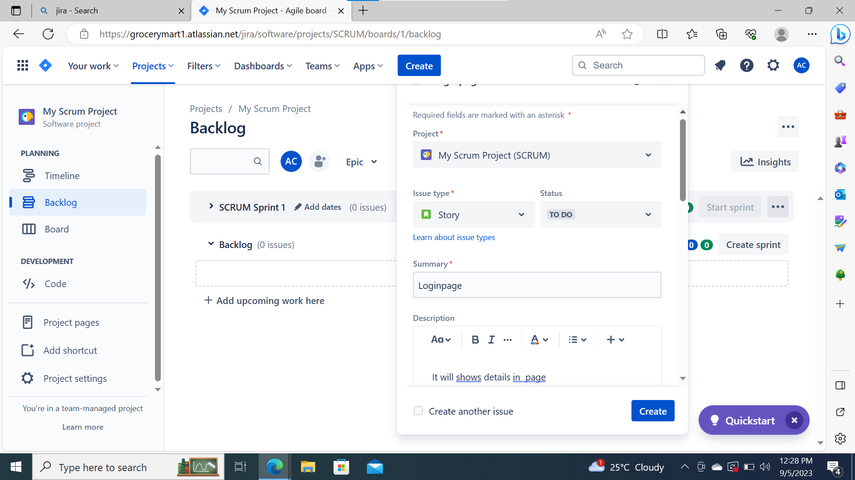
Create a Login page an Story

Slide 7
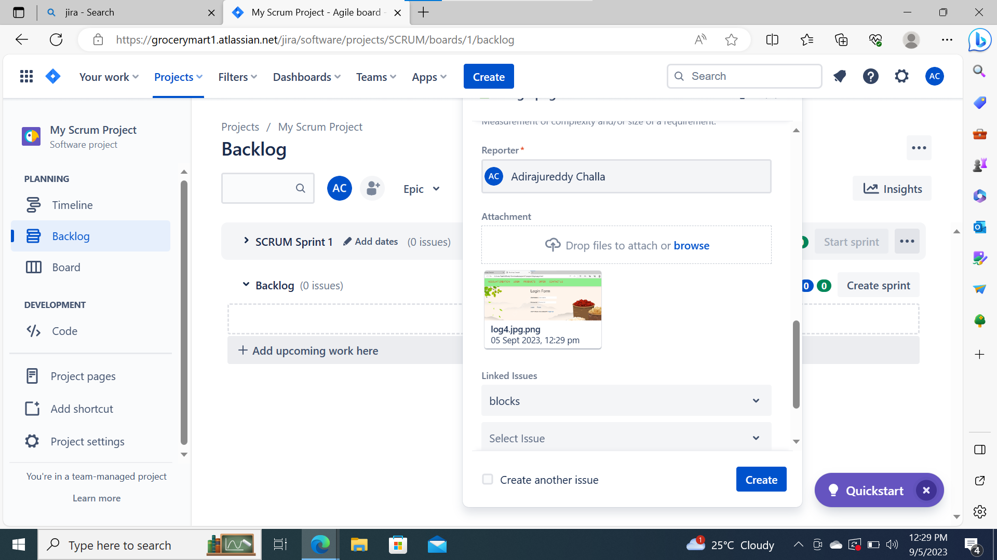

Slide 8
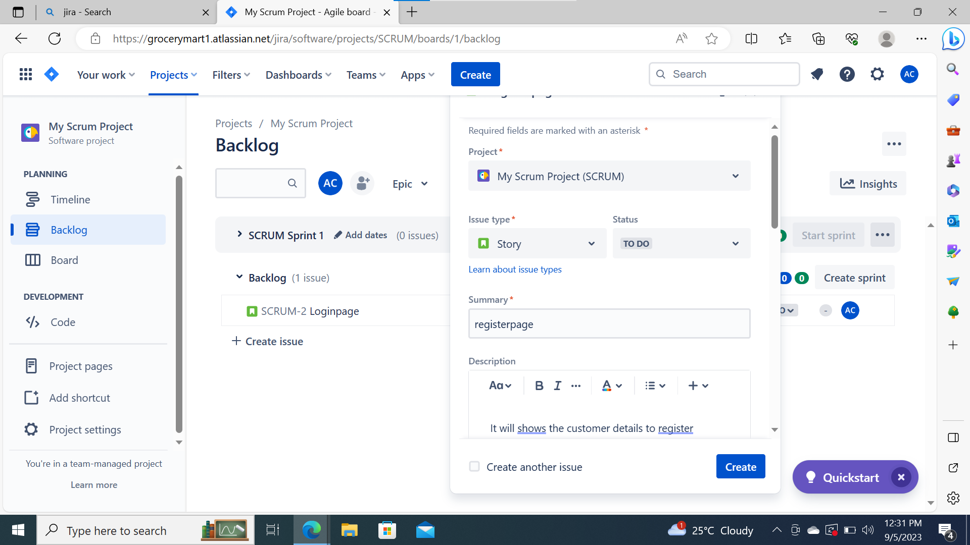
Create a Registerpage as Story

Slide 9
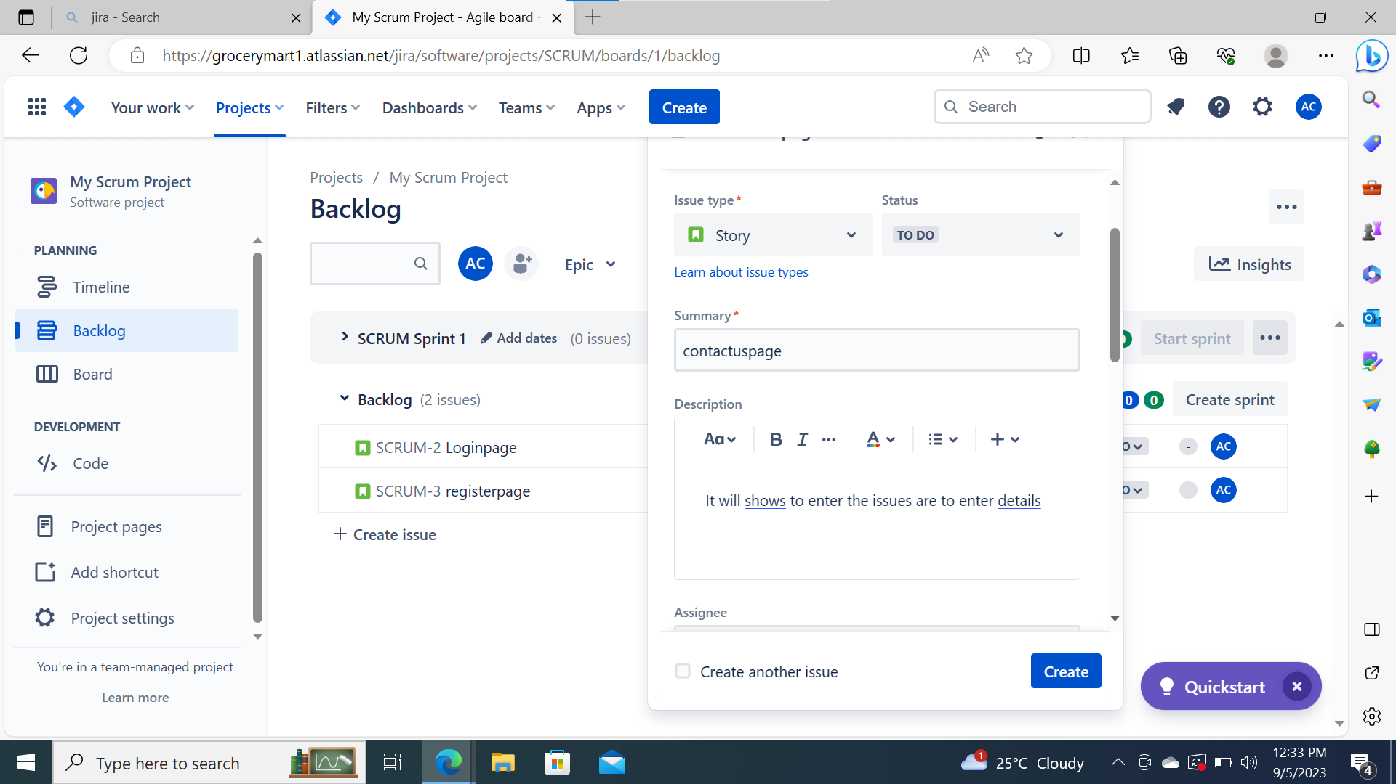
Create a Contact page an Story

Slide 10
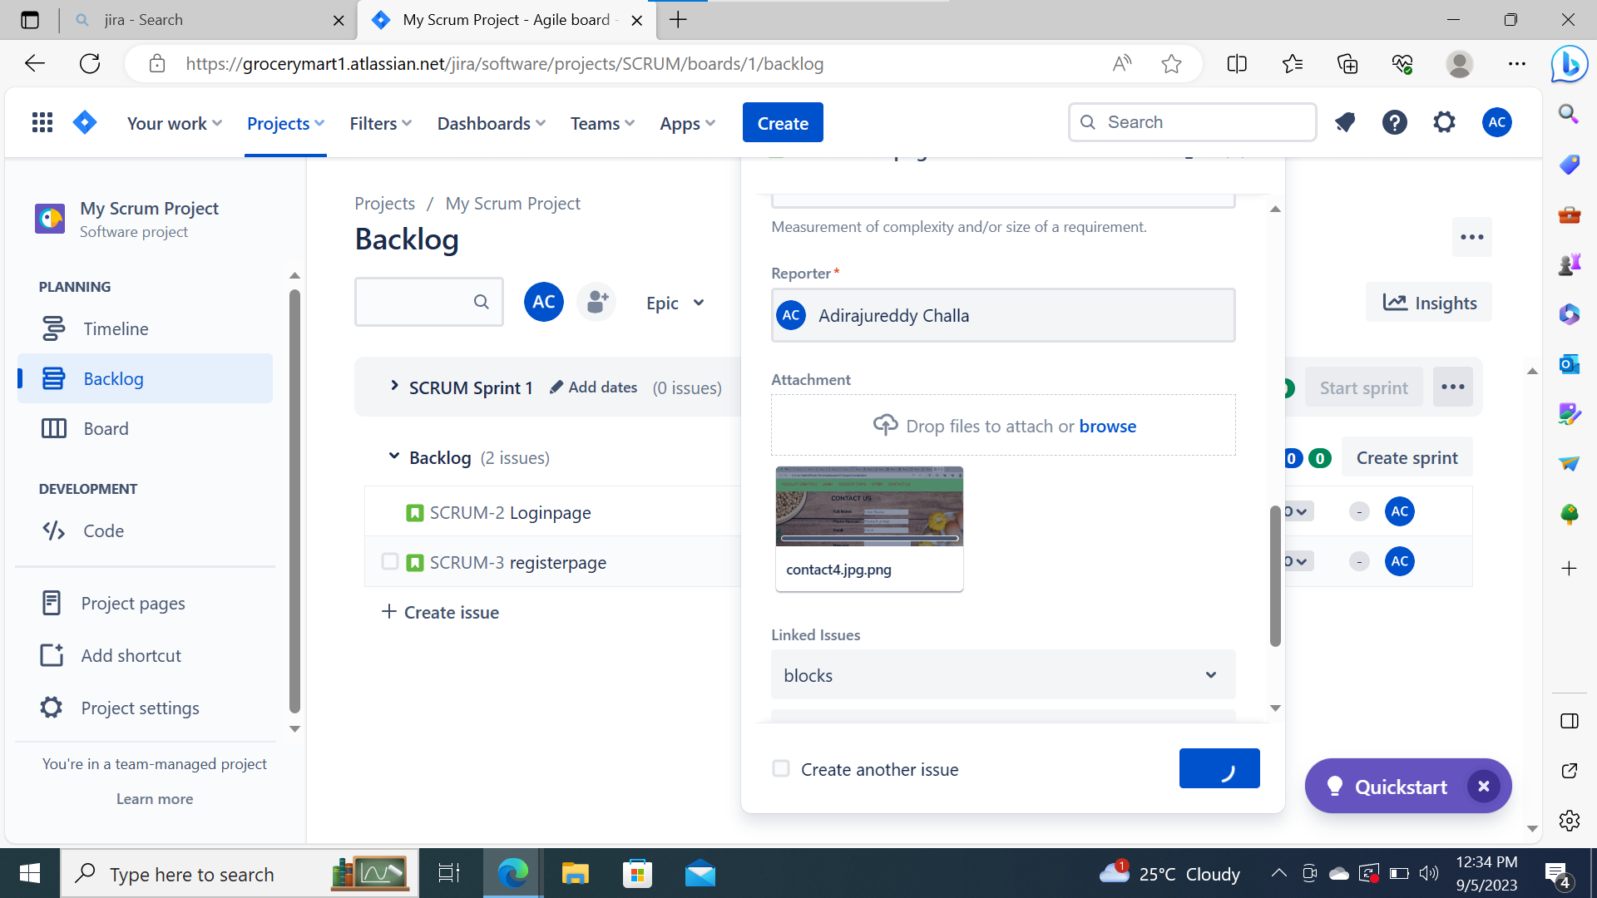

Slide 11
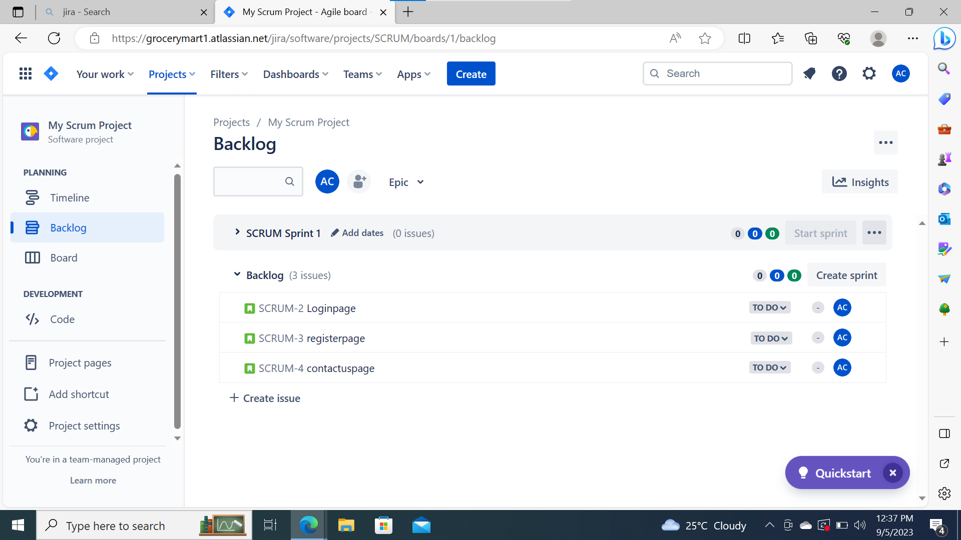
Three storys in Backlog

Slide 12
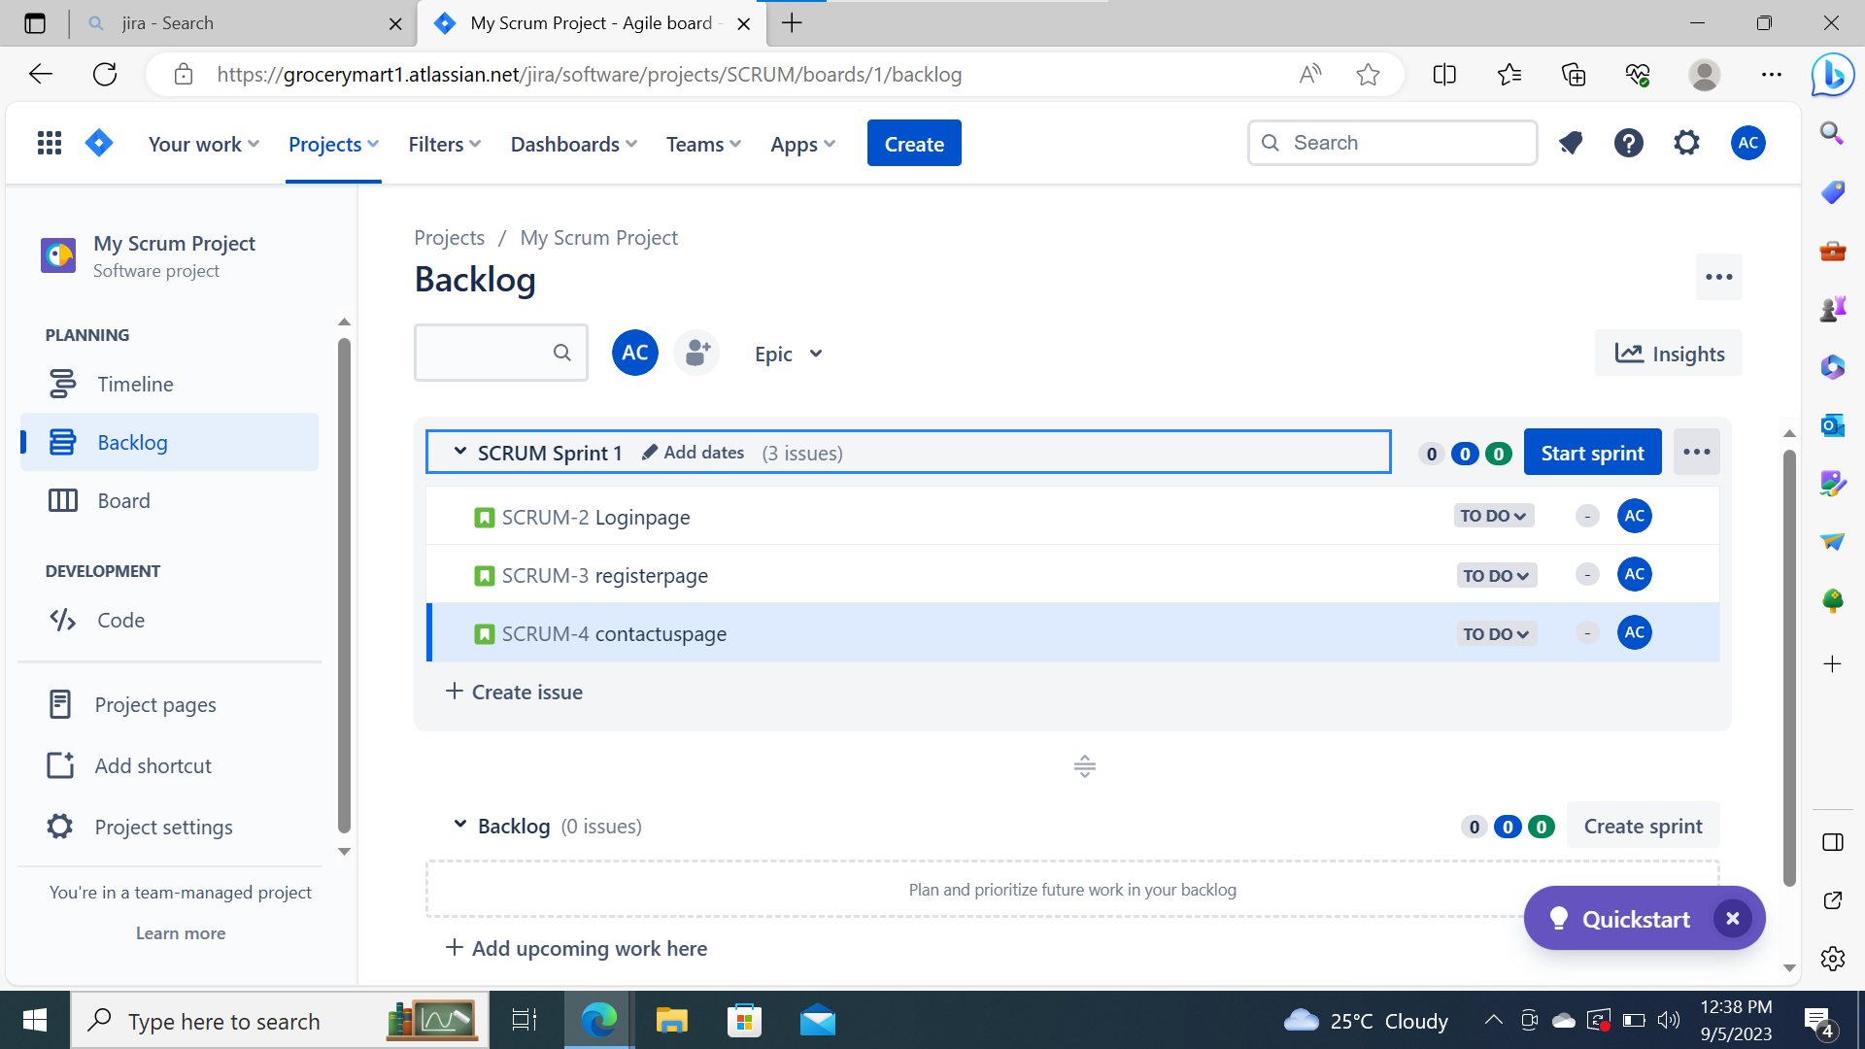
Three Storys in Scrum Sprint

Slide 13
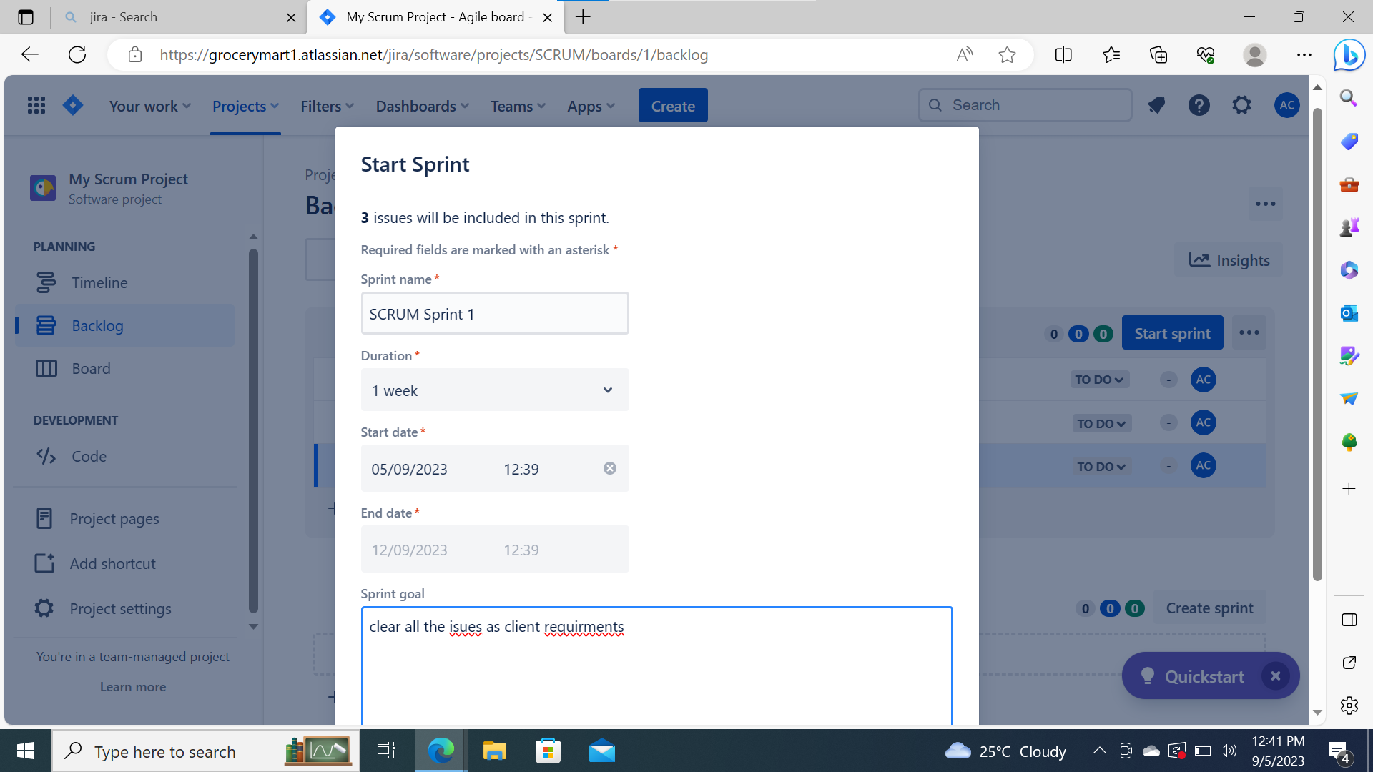
Can Start Sprint

Slide 14
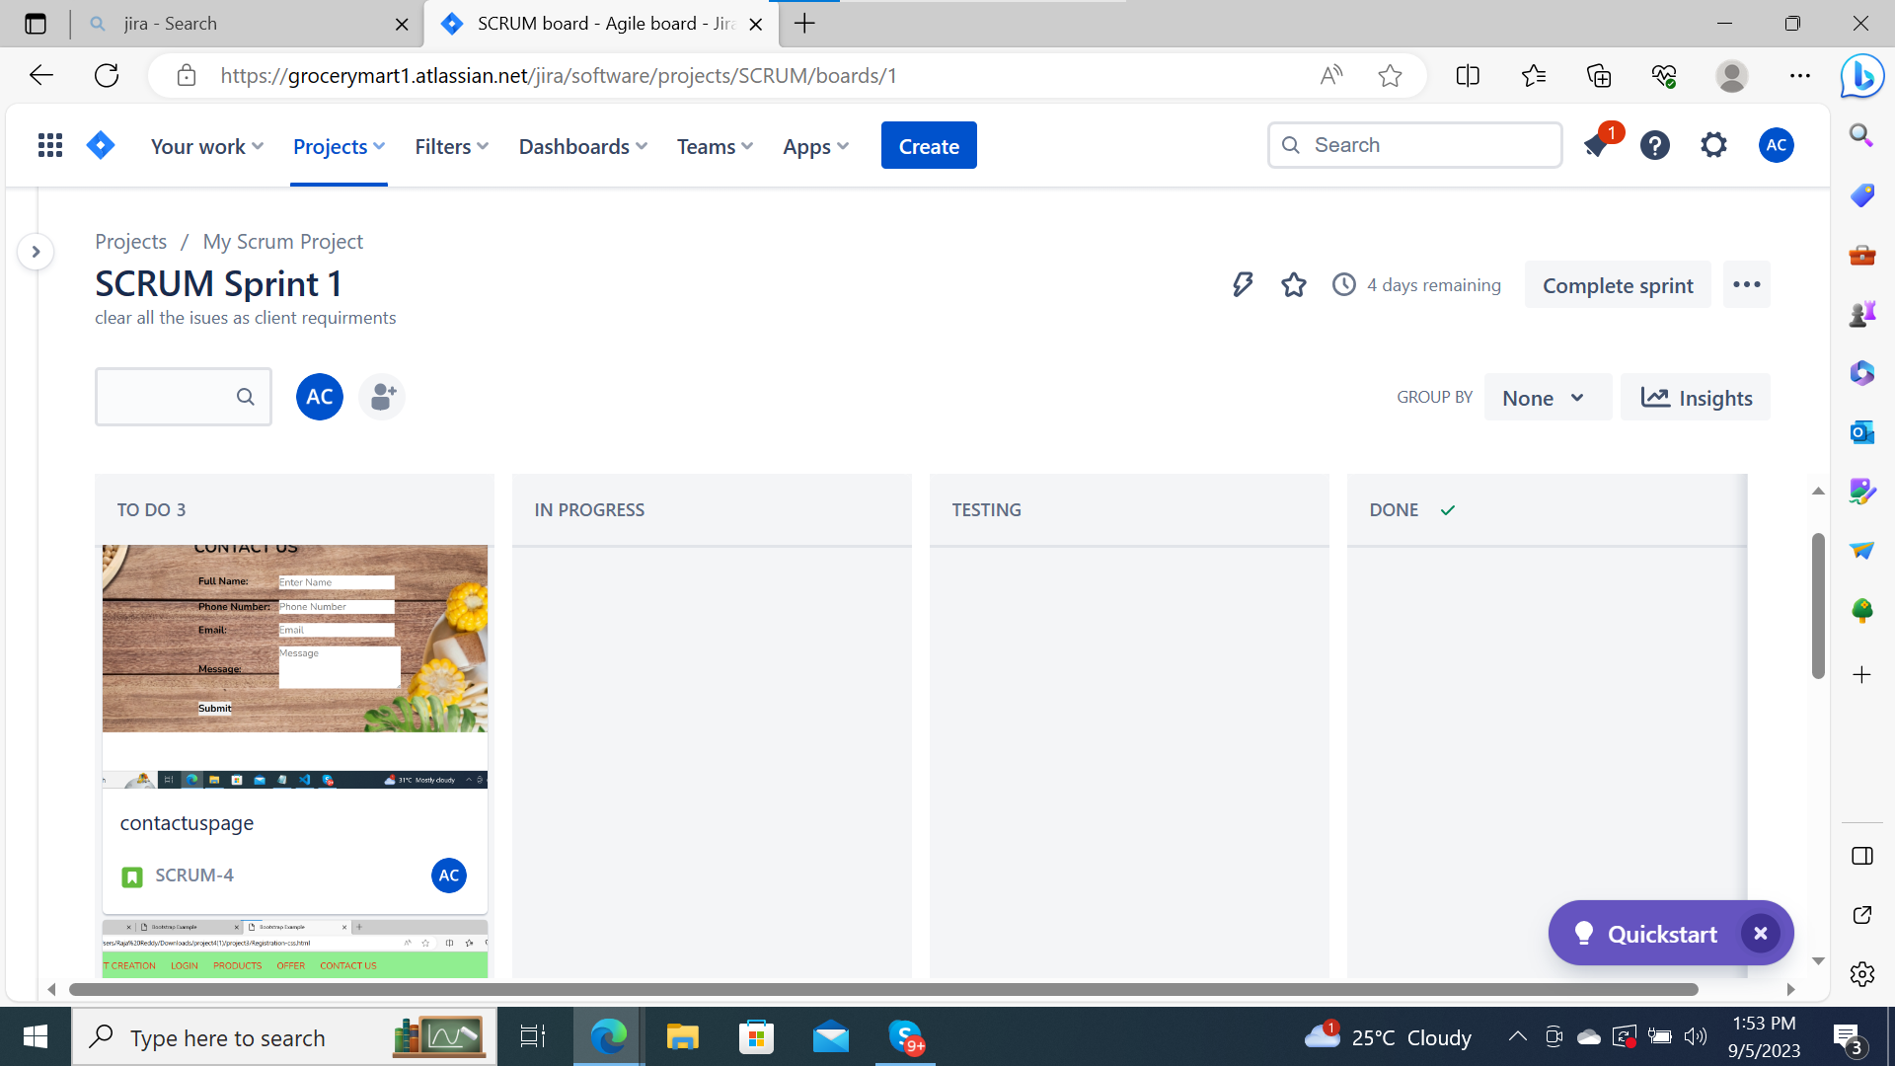
Scrum Sprint

Slide 15
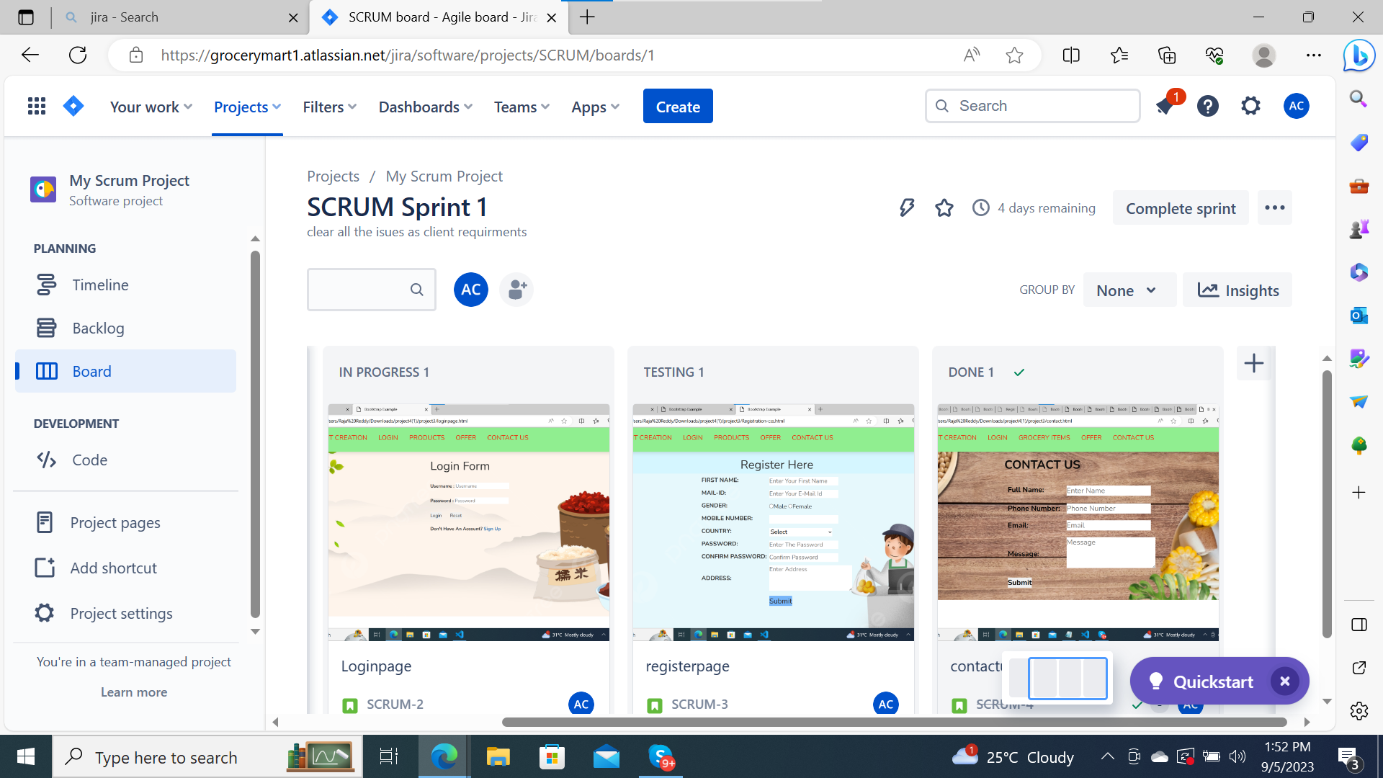
Scrum Sprint stages

Slide 16
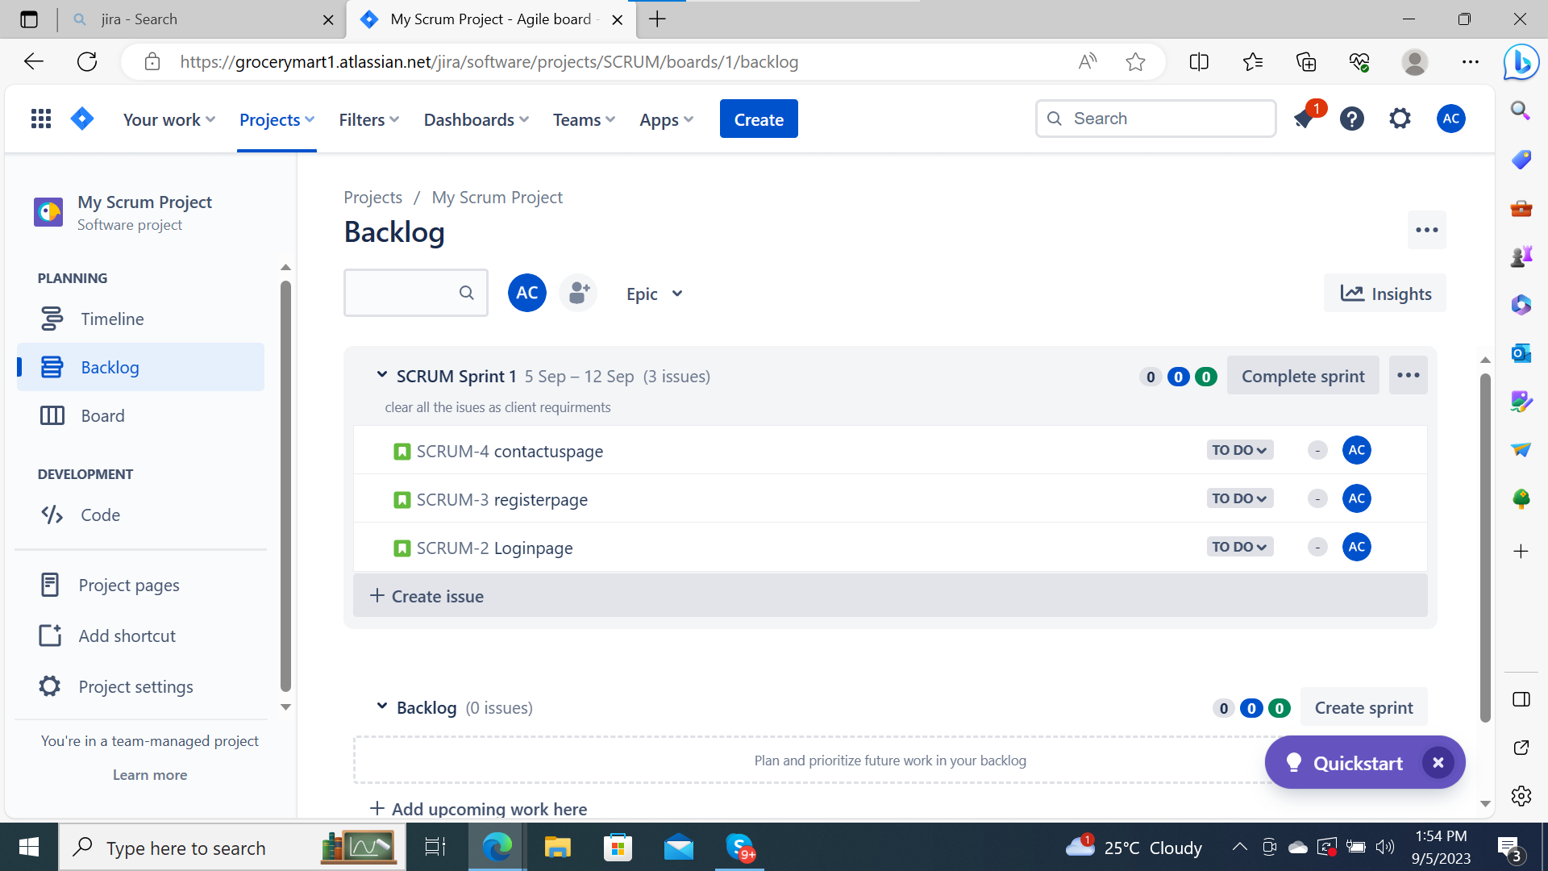
Scrum Sprint status

Slide 17


